Slide 1
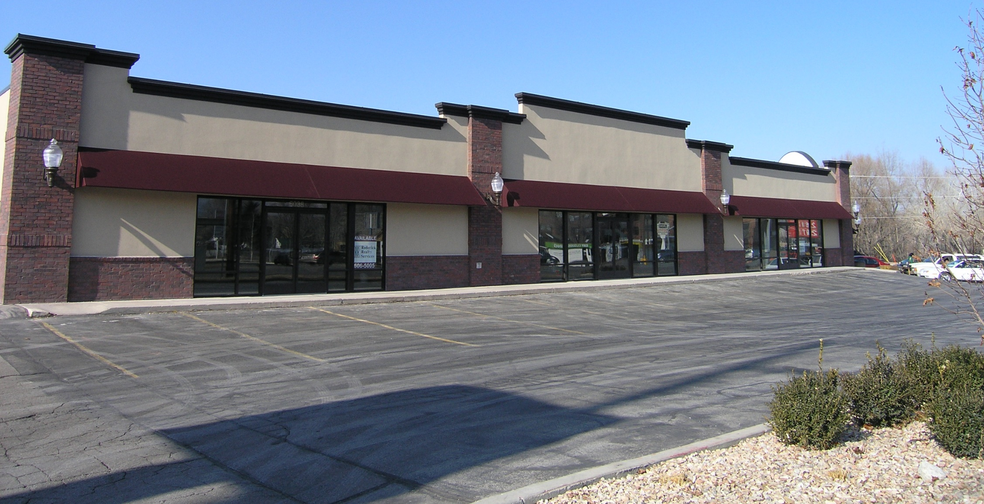
9th & Vine
6000 South (Vine Street) 900 East, Murray, Utah 84107
Roderick Realty
Convenient Hard Corner Location
High Income ($98,316 Average Income)
Dense Population 5 Miles: (344,897)
Easy I-215 Access
52,240 Vehicles per day pass this site
S E R V I C E S
www.roderickrealty.com
801-506-5005

Slide 2
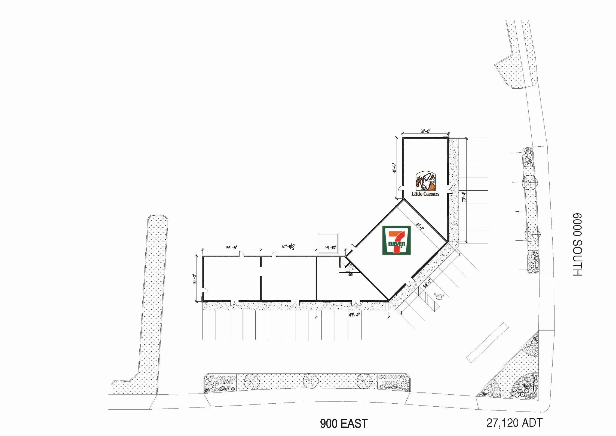
9th & Vine
6000 South (Vine Street) 900 East, Murray, Utah 84107
Space | Tenant | Size
880 | Little Caesars Pizza | 1,747 SF
6032 | 7-Eleven | 2,381 SF
6034 & 6036 | Dollar Loan Center | 2,243 SF
6038 | New California Nails | 1,230 SF
Suite 880
Suite 6032
Suite 6038
Suite 6036
Suite 6034
Roderick Realty
S E R V I C E S
www.roderickrealty.com
801-506-5005
The information contained herein has been given to us by the owner or obtained from other reliable sources. We have no reason to doubt its accuracy but we do not guarantee it. Vacancy factors, projections, opinions, assumptions or estimates used herein are for example only and represents the current or future performance of the property. The value of this investment depends on tax and other factors which should be evaluated by your tax financial and legal advisors. YOU AND YOUR ADVISOR SHOULD VERIFY PROPERTY INFORMATION TO DETERMINE TO YOUR SATISFACTION THE PROPERTY FOR YOUR NEEDS.

Slide 3
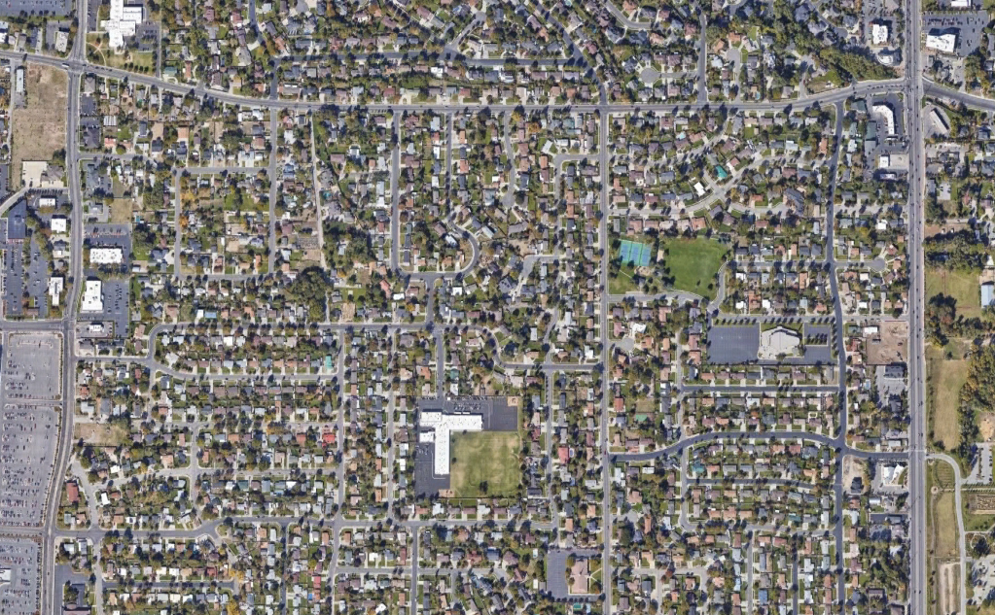
9th & Vine
6000 South (Vine Street) 900 East, Murray, Utah 84107
13,165 ADT (2022)
SUBJECT PROPERTY
39,075 ADT (2022)

